Slide 1
UCM Simulator Test Framework
Python based testing of UCM functionality
Koen Taillaert
Zedelgem, Belgium
May 24th, 2019
Contains confidential proprietary and trade secrets information of CNH Industrial. Any use of this work without express written consent is strictly prohibited.

Slide 2
Contents
Overview
UCM simulator functions
Camel functions
Python and IDE setup
Examples

Slide 3
Windows Simulation
Application DLL
Simulation EXE
Vehicle Code
Callback API
Dspace
XIL
Python
Configuration
App DLL Wrapper
I/O Controls
Plant models
XIL2UCM
UCMSimTest
UCMSimFramework DLL
API
Camel
Vector
PCAN
CanSim
API
CanGateway

Slide 4
UCM Simulator Test Framework Interface
General Overview
Interface: JSON over Windows Named Pipe
UCM simulator for IO access
CAMEL Tool for CAN data
Interface documentation: https://repo.cnhind.com/svn/harvester_libraries/UCMSimFramework/trunk/TestFramework/doc/Ucm_simulation_external_test_framework.docx
Python Test Framework using this interface
UCM simulator and Camel Tool must be running and configured
https://repo.cnhind.com/svn/harvester_libraries/UCMSimFramework/trunk/TestFramework/doc/Ucm_simulation_python_test_env.docx

Slide 5
UCM simulator functions
Setting IO
Detailed description in https://repo.cnhind.com/svn/harvester_libraries/UCMSimFramework/trunk/TestFramework/doc/Ucm_simulation_python_test_env.docx
Setting IO
Different functions for IO Types (analog, switch, frequency, …) cf. UI types
set_io_voltage(spn, voltage)
set_io_frequency(spn, voltage, frequency)
set_io_pulse(spn, voltage, pulses)
set_io_switch(spn, boolean)
set_io_pwm(spn, voltage, period, duty)

Slide 6
UCM simulator functions
Getting IO
Getting IO
Last received IO value is stored in spnlist table
Table 6 - SpnList functionality per input/output type
Set command triggers response with value
get_io_data(spn) : requests SPN data from UCM sim
io_subscribe(spn) : UCM sim sends new value when changed
io_unsubscribe(spn)
set_callback_function(spn, callback)
when spn value received: executes callback function
remove_callback_function(spn)

Slide 7
UCM simulator functions
SpnList functionality
function | Voltage Input | Frequency Input | Pulse Input | Digital Input | PWM Input | Digital Output | PWM Output
all_data(spn) | V | V | V | V | V | V | V
remove(spn) | V | V | V | V | V | V | V
type(spn) ^{(*2)} | V | V | V | V | V | V | V
voltage(spn)^{(*1)} | V | V | V | V(*4) | V | V
frequency(spn) ^{(*1)} |  | V
increment(spn) ^{(*1)} |  |  | V
period(spn) ^{(*1)} |  |  |  |  | V
duty(spn) ^{(*1)} |  |  |  |  | V |  | V
switch(spn) ^{(*1)} |  |  |  | V(*5)
current(spn) ^{(*1)} |  |  |  |  |  | V | V
error(spn) ^{(*3)} | V | V | V | V | V | V | V
Table 6 - SpnList functionality per input/output type
(*1) Return value is according to Table 5 – UCM input function overview
(*2) Return value is according to type value from Table 3 - UCM supported input types and Table 4 - UCM supported output types
(*3) returns “none” when no error is recorded, otherwise error text as per protocol spec[1]
(*4) Valid only after set_io_voltage or get_io_data call
(*5) Valid only after set_io_switch or get_io_data call

Slide 8
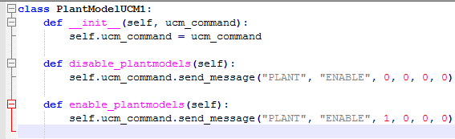
UCM simulator functions
Custom commands
Custom command pass through
Write your own plant model controls
Register Callback from UCM sim application
UCM sim: FrameworkCore.ExternalTestModule.RegisterReceivedDataCallback
Python: Use send_message(string,string,float,float,float,float) function to send messages
Bypass commands from Ucm_simulation_external_test_framework.docx Table 4
Example from sugarcane

Slide 9
Camel functions
Signal based
Referenced by CAN DB signal name
SignalId : bus number, source address, message name, signal name
flash_indic = SignalId(CAN_BUS_1, 0x80, 'ucm1_status', 'flash_indicator')
Last value is stored in SignalList table
set_signal_value(sigid, value)
Also triggers response
get_signal_value(sigid)
signal_subscribe(sigid): subscribe to CAN signal.
signal_unsubscribe(sigid)
set_signal_callback_function(sigid, callback)
when can value received: executes callback function
remove_signal_callback_function(sigid)

Slide 10
Camel functions
PGN based
Referenced by PGN
Raw can data
PgnId: bus number, source addr, PGN, (optional multiplex)
Last value is stored in PgnList table
set_pgn_data(pgngid, value)
Also triggers response
get_pgn_data(pgnid)

Slide 11
Camel functions
CCS settings
CCS settings
Referenced by CCS setting id
set_ccs_value(ccs_id, value) : set the value of the setting
Camel will send 0xCC token with SA 0x90
get_ccs_value(ccs_id): get the value of the setting
Last value is stored in CCSList table
ccs_list.value(ccs_id)

Slide 12
Python requirements
Python :
Minimum version required: Python 3.5 (https://www.python.org/downloads/)
Pywin32 (minimum version 244) (https://pypi.org/project/pywin32/
Pytest (minimum version 4.0.2) (https://docs.pytest.org/en/latest/getting-started.html
IDE development :
Easy development and Python setup
PyCharm Community Edition (https://www.jetbrains.com/pycharm/)
Cmd line deployment :
For automatic testing
Needs ntlm proxy setup (http://cntlm.sourceforge.net/) to work on CNHI network

Slide 13
Installation for IDE development
Install Python :
Minimum version required: Python 3.5
https://www.python.org/downloads/
Install PyCharm Community Edition :
https://www.jetbrains.com/pycharm/

Slide 14
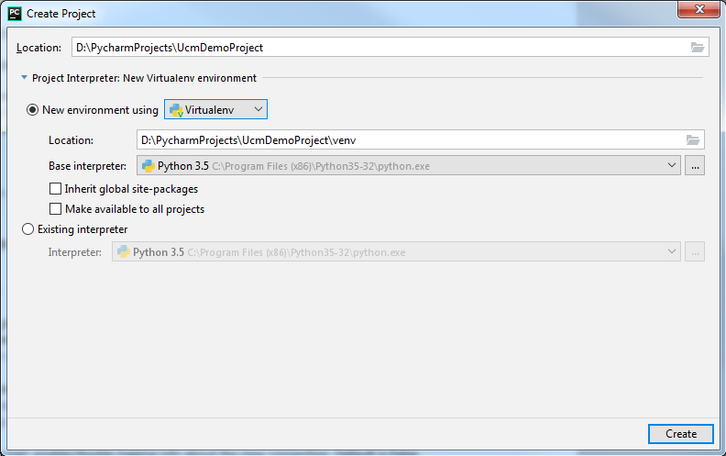
PyCharm IDE setup
Create Project
File → New Project

Slide 15
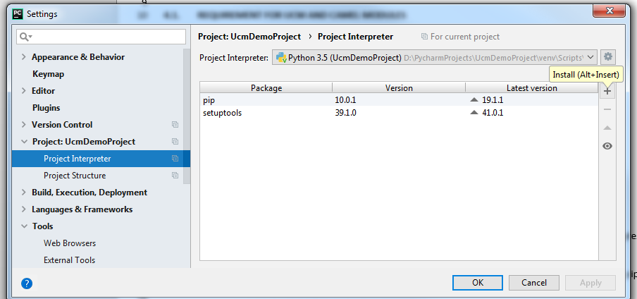
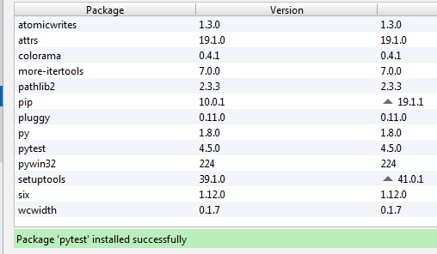
PyCharm IDE setup
Install modules
File → Settings →Project→ Project Interpreter
Install «pywin32» and «pytest»

Slide 16
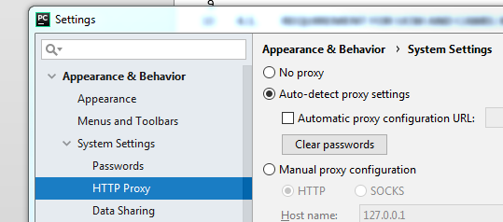
PyCharm IDE setup
Proxy configuration
File → Settings → Appearance & Behavior → System Settings → HTTP Proxy → Auto-detect proxy settings

Slide 17
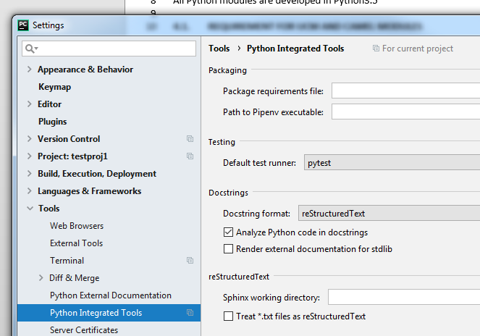
PyCharm IDE setup
Pytest integration
File → Settings → Tools→ Python Integrated Tools→ Testing→ Default test runner → pytest

Slide 18
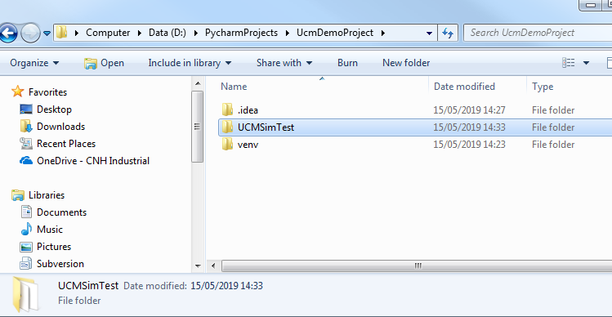
Test development in IDE
Add UCMSimTest
Copy UCMSimTest in the project
https://repo.cnhind.com/svn/harvester_libraries/UCMSimFramework/trunk/TestFramework/UCMSimTest

Slide 19
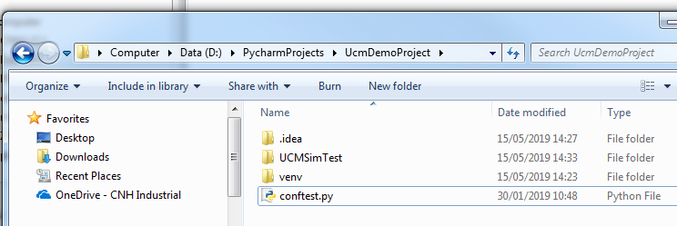
Test development in IDE
Add conftest.py
Copy conftest.py in the project (pytest configuration file example)
https://repo.cnhind.com/svn/harvester_libraries/UCMSimFramework/trunk/TestFramework/example/conftest.py

Slide 20
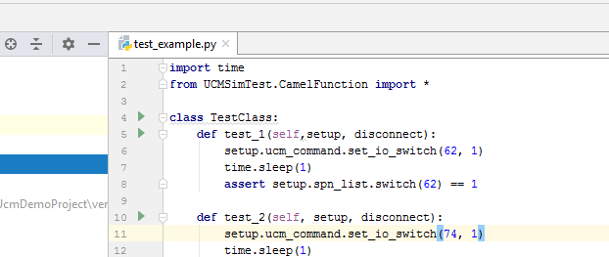
Test development in IDE
Run from UI
Run 1 test, or all tests from UI by pressing green arrow next to class (all tests) or 1 specific test,

Slide 21
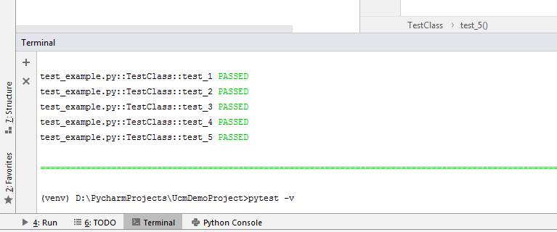
Test development in IDE
Run from terminal
Run via built-in terminal

Slide 22
Pytest
Full documentation available at https://docs.pytest.org/en/latest/
“pytest” will run all files of the form test_*.py or *_test.py in the current directory and its subdirectories
Create xml output
pytest --junitxml=report.xml
For html reports: install «pytest-html» package
pytest --html=report.html
https://pypi.org/project/pytest-html/
Advanced example:
https://repo.cnhind.com/svn/sugarcaneharvester/trunk/test

Slide 23
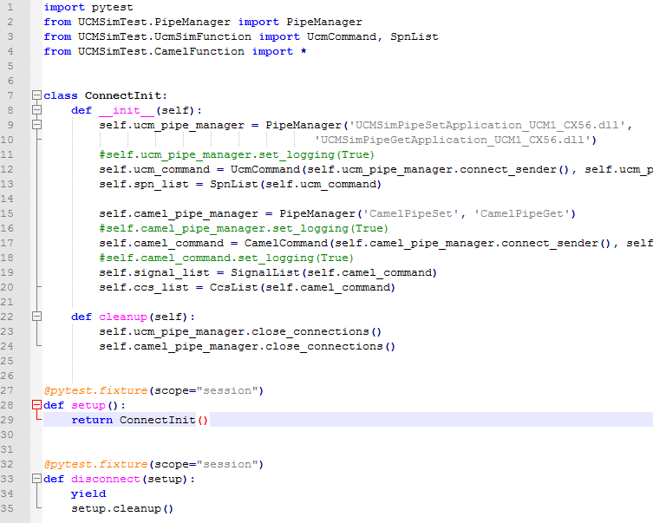
Conftest.py example
Import statements
Configure the test environment: set up connections to the Simulator(s) and Camel Tool
Execute once to set up environment
Execute once after all tests have been executed (“yield”) to clean up environment

Slide 24
Conftest.py example
Setting up the connections
PipeManager('UCMSimPipeSetApplication_UCM1_CX56.dll‘, 'UCMSimPipeGetApplication_UCM1_CX56.dll')
Sets up connection to UCM simulator
Create multiple PipeManagers to use multiple UCM simulators simultaneously
UcmCommand(self.ucm_pipe_manager.connect_sender(), self.ucm_pipe_manager.connect_receiver())
Connects UCM command module to the pipes
SpnList(self.ucm_command)
Links the UCM command module to the SpnList
PipeManager('CamelPipeSet', 'CamelPipeGet')
Sets up connection to Camel Tool
Only 1 Camel tool connection possible
CamelCommand(self.camel_pipe_manager.connect_sender(), self.camel_pipe_manager.connect_receiver())
Connects Camelcommand module to the pipes
SignalList(self.camel_command)
Links the UCM command module to the SignalList
CcsList(self.camel_command)
Links the UCM command module to the SignalList
https://repo.cnhind.com/svn/harvester_libraries/UCMSimFramework/trunk/TestFramework/doc/Ucm_simulation_external_test_framework.docx

Slide 25
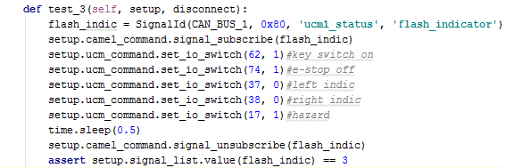
Test example
Link to Setup & Teardown cf conftest.py
Subscribe to the flash indicator signal
Set all required IO
Give time for CAN signal to be set
Unsubscribe the can signal
Check if signal has expected value

Slide 26
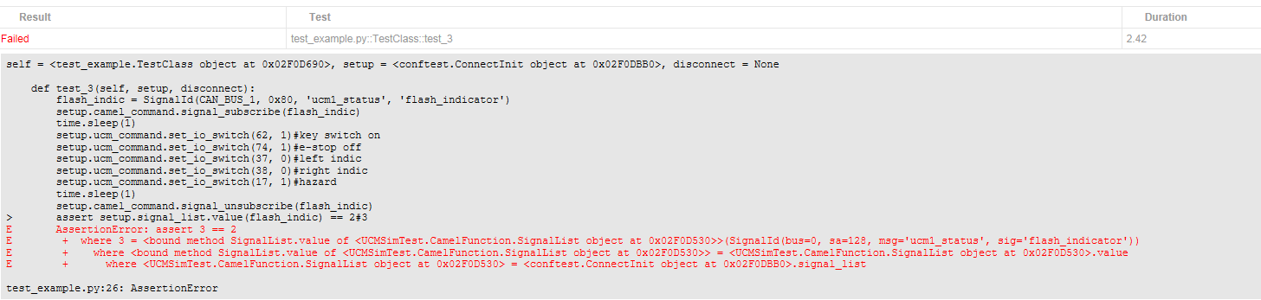
Test example failure

Slide 27
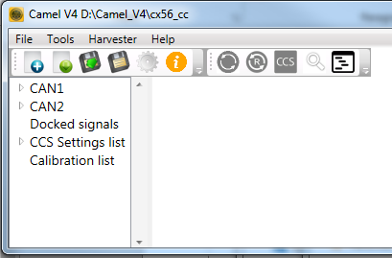
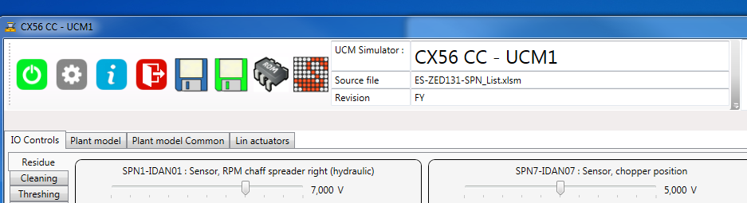
Executing tests
Camel Tool and UCM simulator must be running and configured
Switch off in Camel Tool:
CCS Master mode
Cyclic can messages (for nodes that are controlled by UCM sim)

